Slide 1
Practical Statistics via python – Session 2
Instructor: Rasha Sadeq Abdin

Slide 2
Agenda
Types of Data in statistics
Types of Data in python
Introduction to Pandas

Slide 3
Why to understand the type of data
To assist in summary statistic.
To facilitate the visualization (graphs) technique to be used.
Analysis required.

Slide 4
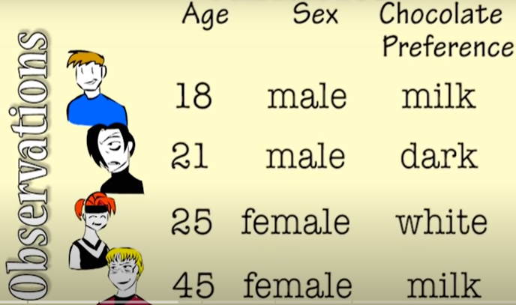
Why to understand the type of data
Variables

Slide 5
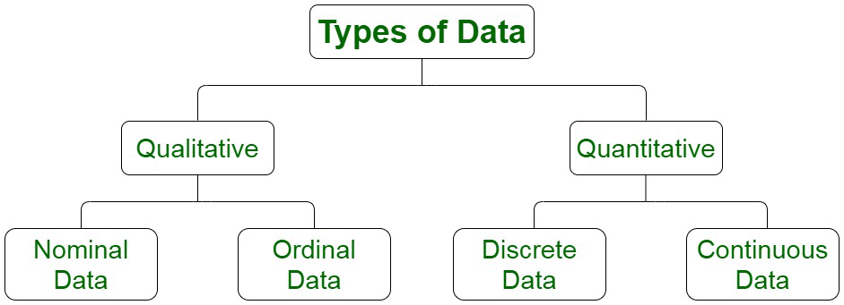
Types of data in statistics
Categorical
Numerical
Notes:
Session 2 with pandas

Slide 6
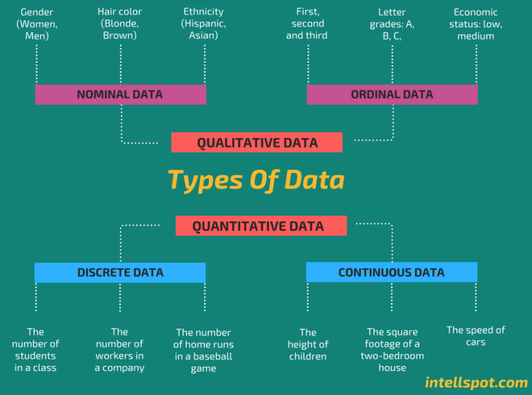
Types of data

Slide 7
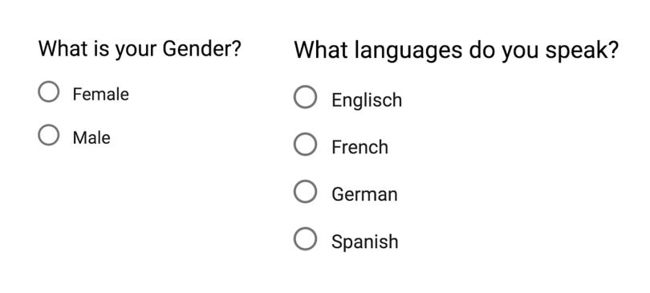

Types of data
Nominal
Ordinal

Slide 8
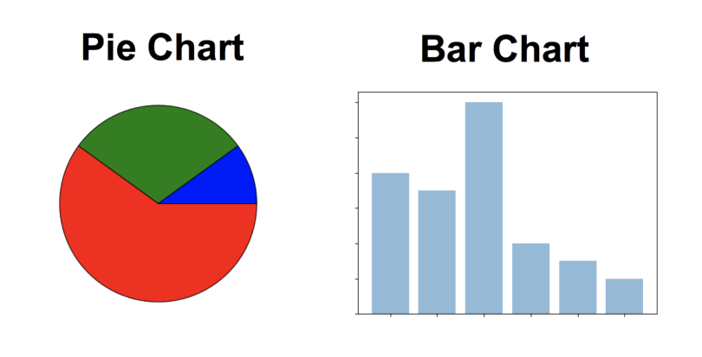
Types of data in statistics
Qualitative – Categorical | Nominal | Ordinal
 | There are not stored in order | They have order, and sequence
 | Can be stored in text, words, or numerical code | Can be stored in text, and words
 | Example: Male, Female Dark, Milk, Chocolate Yellow, green , White, Red | Example: Rank, Satisfaction level
 | Can be represented by frequency and percentage 20%, 50%, 25% or any | Can be represented by frequency and percentage 20%, 50%, 25% or any
 | Mean can’t be calculated | Mean can’t be calculated
Visualization Methods | Use a pie chart or a bar chart | Use a bar chart

Slide 9
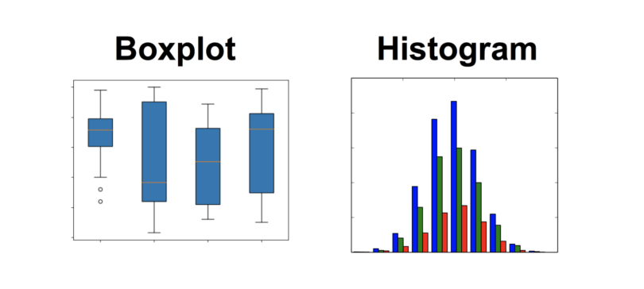
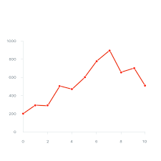
Types of data in statistics
Quantitative – Numerical | Discrete | Continuous
 | Can be counted with whole numbers | Is given as fractional numbers
 | Example: 5 customers 25 students 30 stores | Example: 15.6 rain level 20.5 degrees 5.5 minutes 4.5 miles
 | Mean, median, standard deviation | Mean, median, standard deviation
Visualization Methods | Line chart | histogram or a boxplot

Slide 10
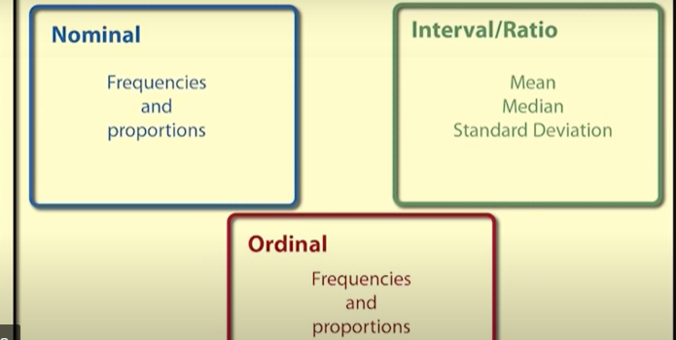
Types of data in statistics

Slide 11
Why to understand the type of data
Data types are an important concept because statistical methods (mean, median, frequencies) can only be used with certain data types. You have to analyse Quantitative data differently than categorical data otherwise it would result in a wrong analysis. Therefore knowing the types of data you are dealing with, enables you to choose the correct method of analysis.

Slide 12
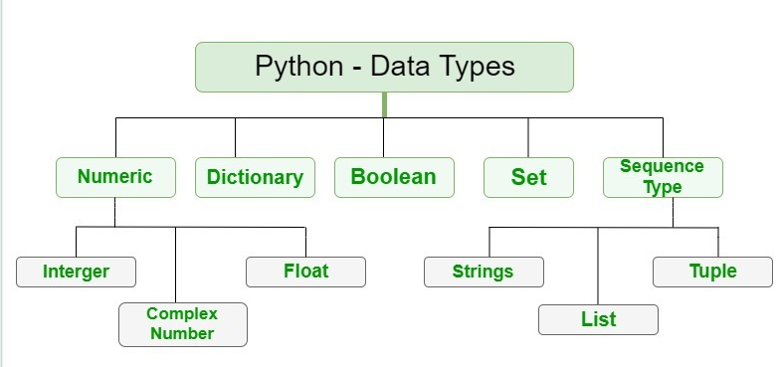
Data types in python

Slide 13
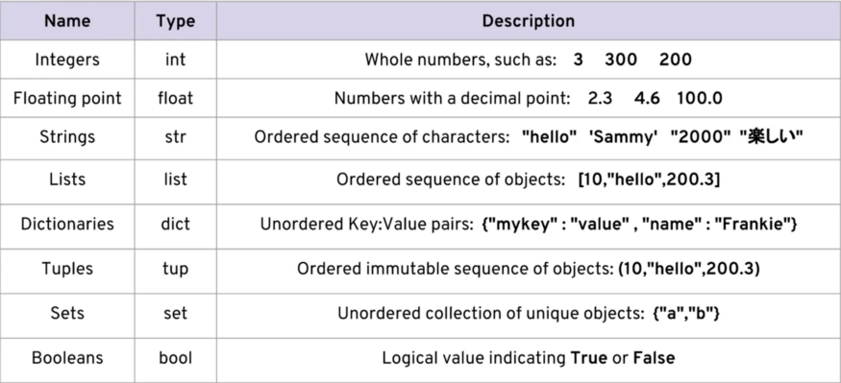
Data types in python

Slide 14
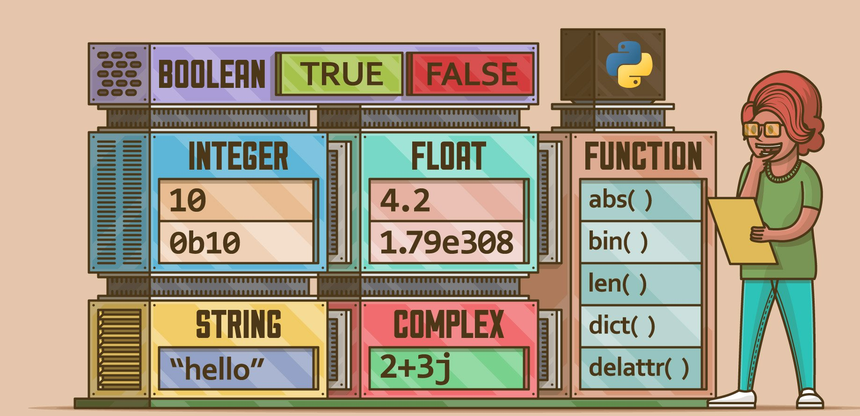
Data types in python

Slide 15
Data types in python
1. Determine and print the type of the following variables
variable1 = 123
variable2 = "123"
variable3 = 123.456

Slide 16
Data types in python
#These codes print the data types
print(type(variable1))
print(type(variable2))
print(type(variable3))
…………………………….
<class 'int'>
<class 'str'>
<class 'float'>

Slide 17
Introduction to Pandas

Slide 18
What is pandas
Pandas is a Python library providing high-performance, easy-to-use data structures and data analysis tools for the Python programming language
Pandas is a python package providing fast, flexible, and expressive data structures designed to make working with data both easy and intuitive. It aims to be the fundamental high-level building block for doing practical, real-world data analysis in Python
Pandas is used for data cleaning, analysis, manipulation, and exploration of data. Which is an essential step for machine learning projects.

Slide 19
What can pandas do?
Fast and efficient DataFrame object with default and customized indexing.
Tools for loading data into in-memory data objects from different file formats.
Data alignment and integrated handling of missing data.
Reshaping and pivoting of date sets.
Label-based slicing, indexing and subsetting of large data sets.
Columns from a data structure can be deleted or inserted.
Group by data for aggregation and transformations.
High performance merging and joining of data.
Time Series functionality.

Slide 20
Pandas and Data Structure
Pandas deals with the following three data structures −
Series
DataFrame
Panel
It deals with: Data frames (2Dimension), and series (1Dimension)

Slide 21
Pandas and Data Structure
A Data frame is a two-dimensional data structure (table), i.e., data is aligned in a tabular fashion in rows and columns. In addition, it should be indexed
Series is a one-dimensional labeled array capable of holding data of any type (integer, string, float, python objects, etc.). The axis labels are collectively called index.

Slide 22
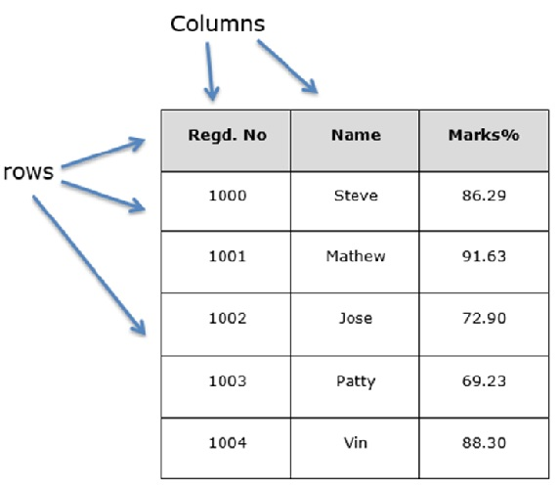
Pandas and Data Structure

Slide 23
Pandas and Data Structure
Features of DataFrame
Potentially columns are of different types
Size – Mutable
Labeled axes (rows and columns)
Can Perform Arithmetic operations on rows and columns

